Slide 1
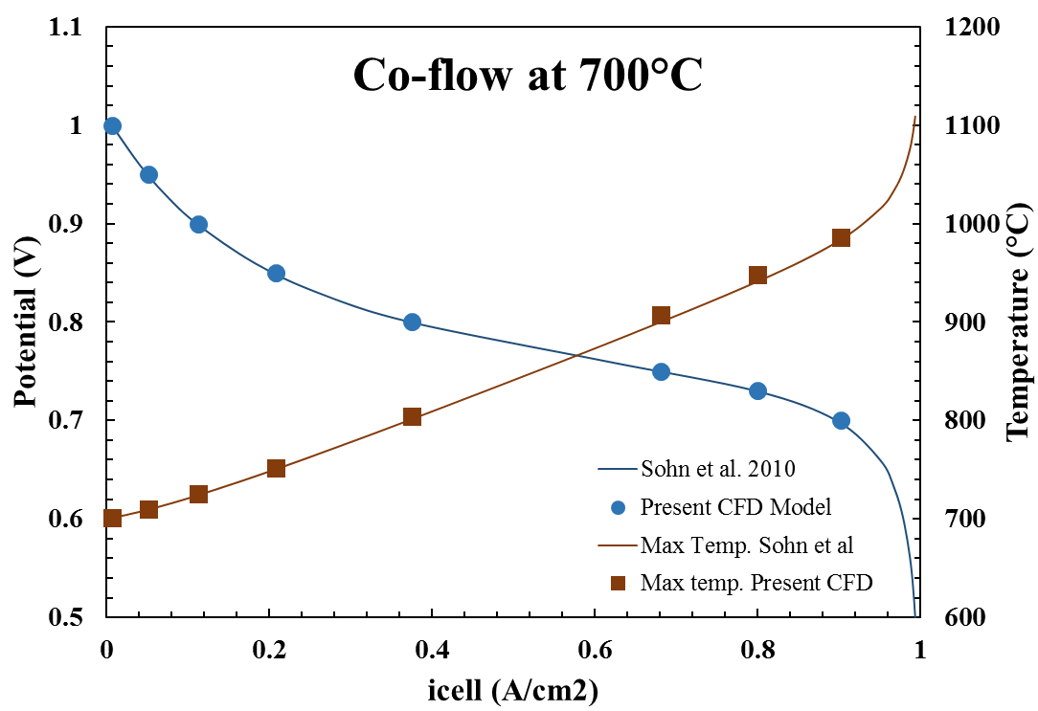
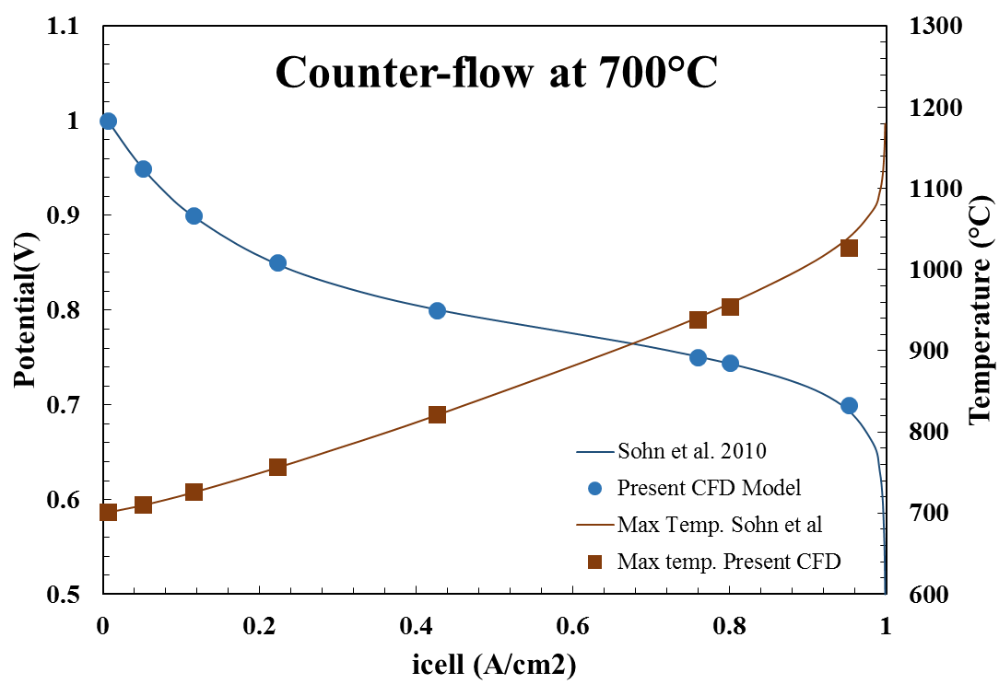
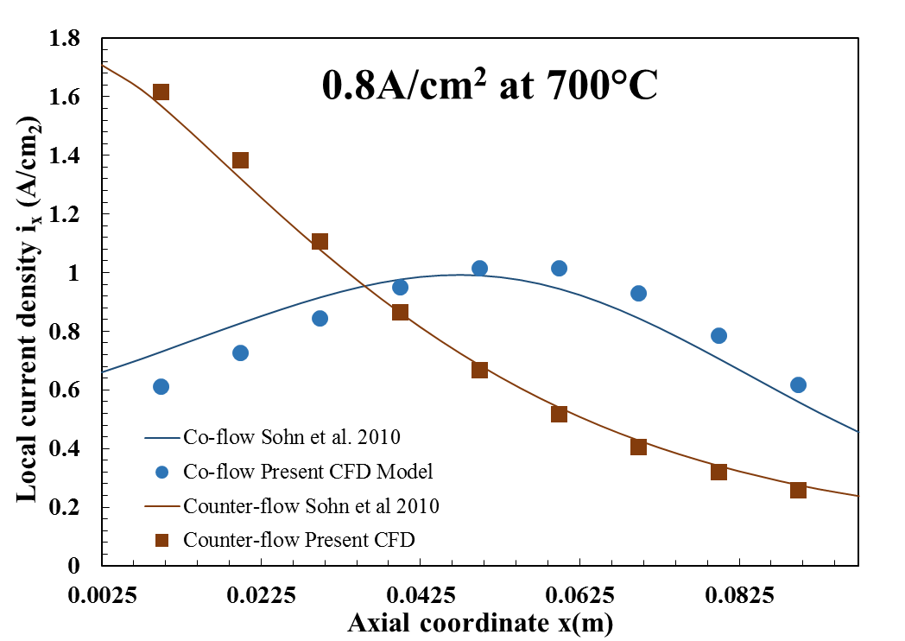
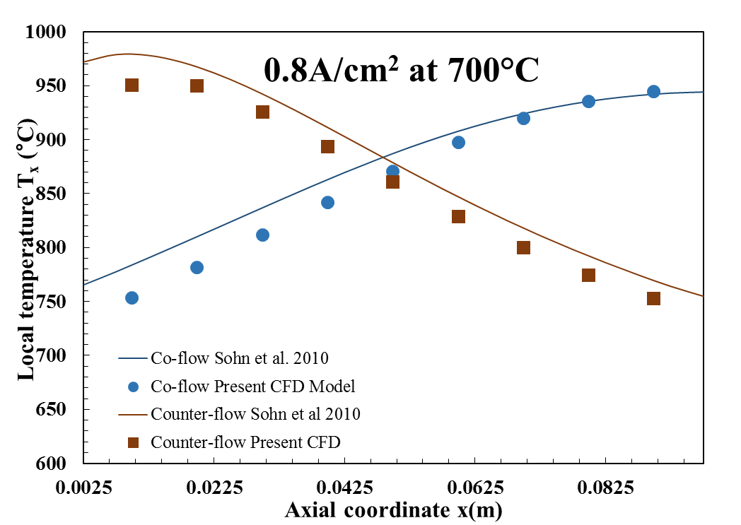
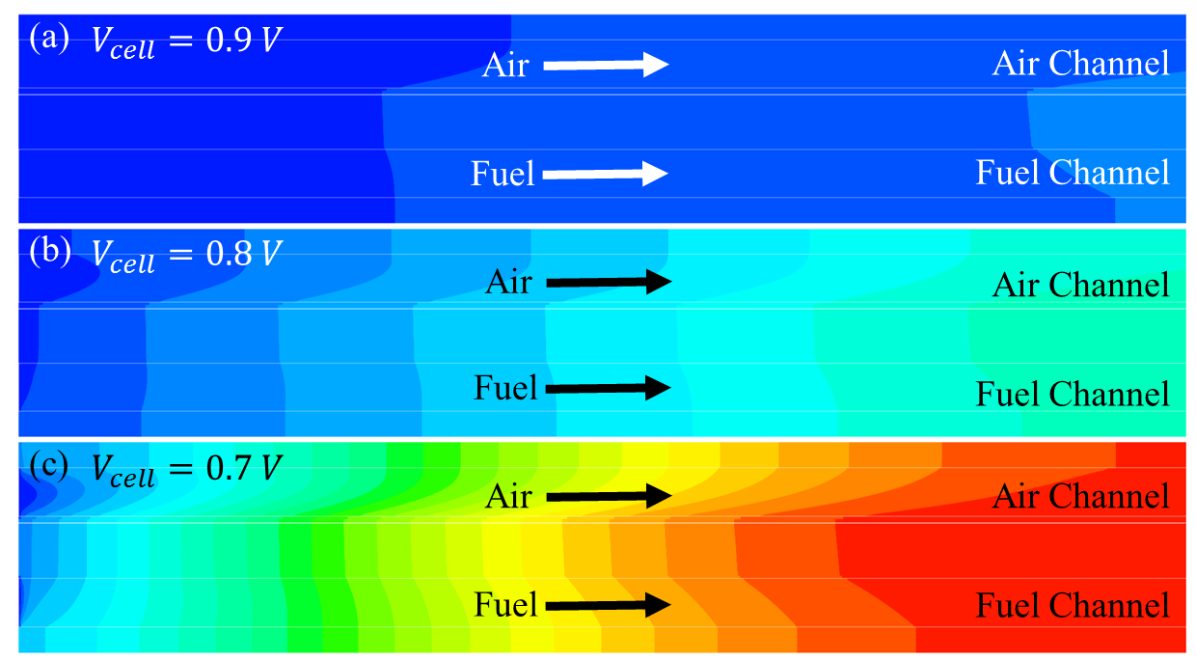
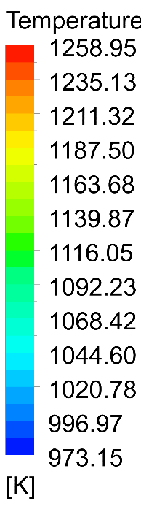
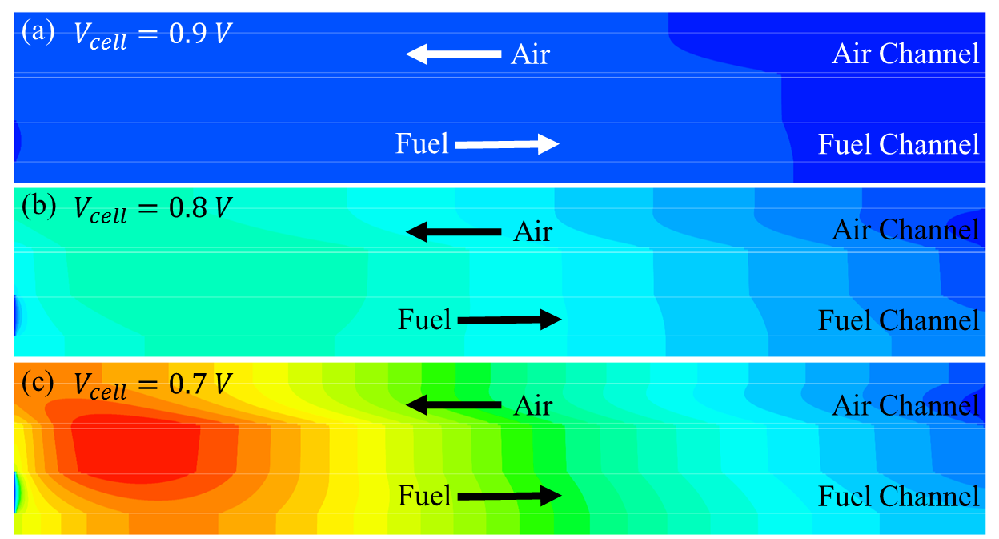
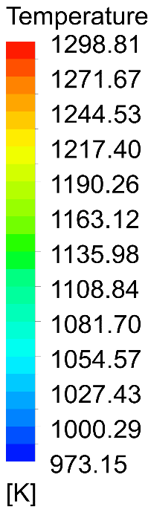

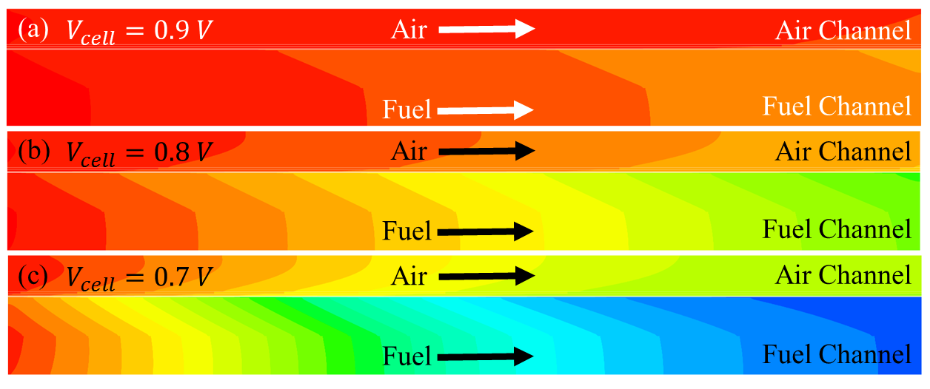


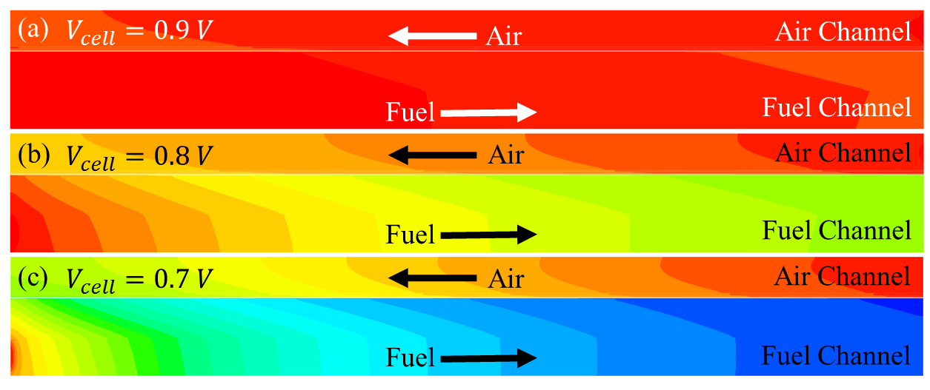
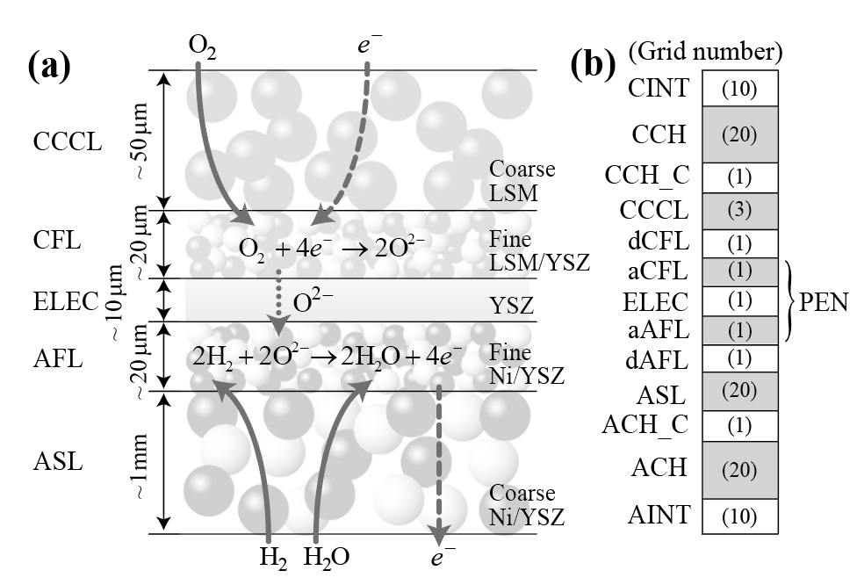
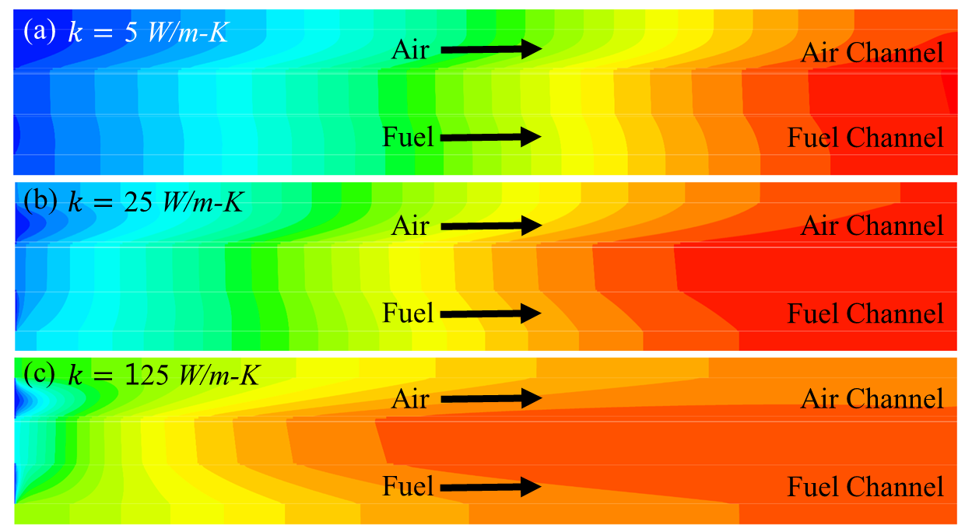
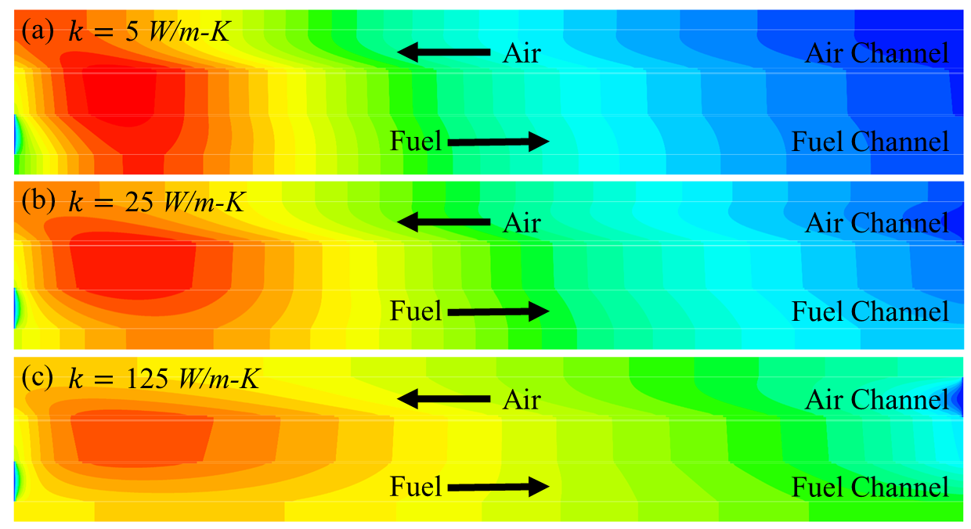
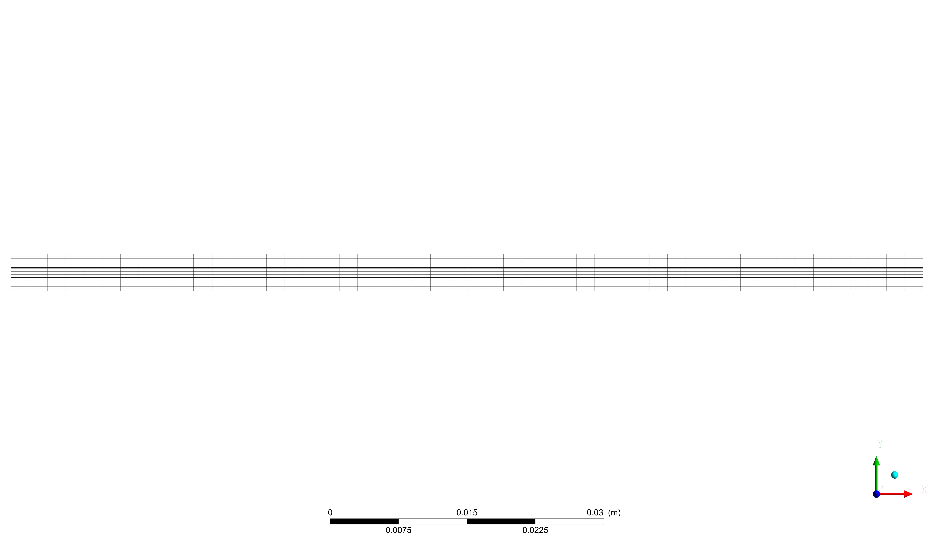
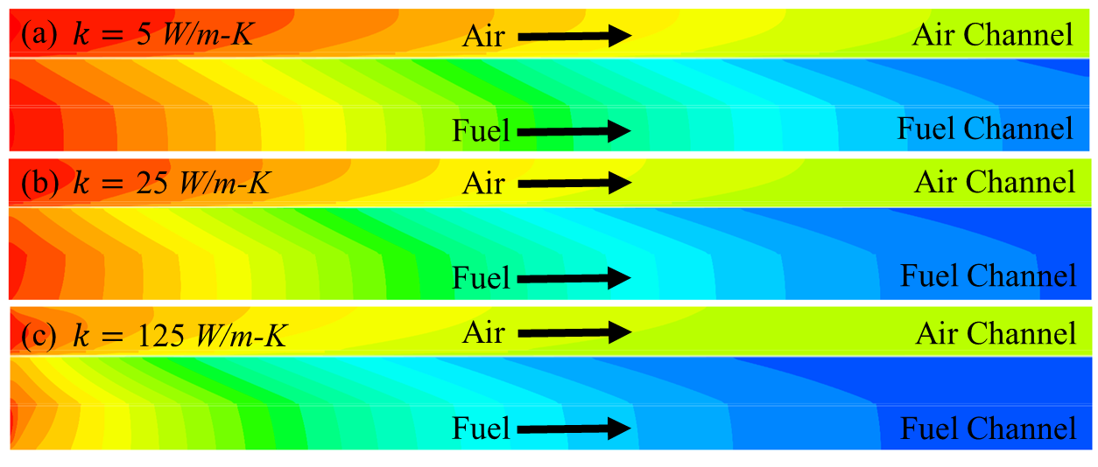
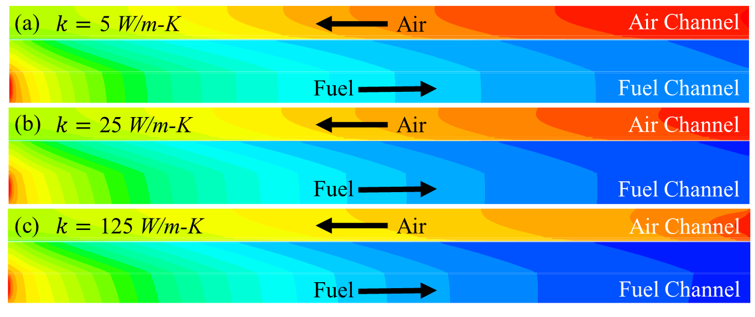
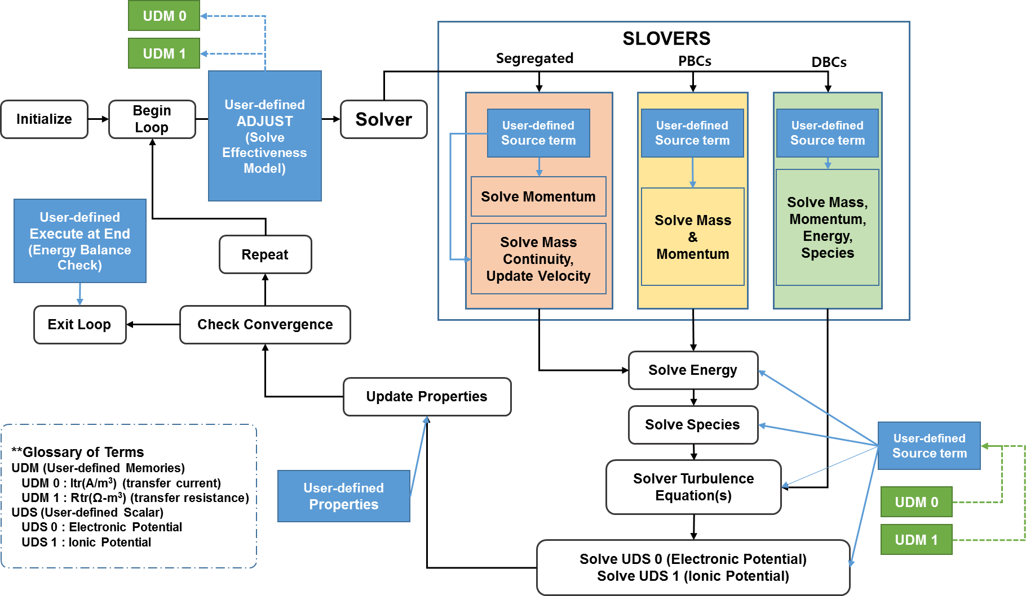
Micro/CFD model development for solid oxide fuel cells based on electrochemical effectiveness model
Areum Jeong¹ , Jaeyeung Song¹ , Jin Hyun Nam^{2*}, Charn-Jung Kim¹
¹School of Mechanical & Aerospace Engineering, Seoul National University, KOREA
²School of Mechanical Engineering, Daegu University, KOREA
Research Objectives
Validation with Microscale Model & Results
• Objectives
• Current - voltage curve
Electro chemical effectiveness model can be properly incorporated with CFD simulation codes, reducing computational costs allowing the consideration of microstructural effects
Too many grid points are required for conventional microscale model to capture the reaction/transport process in mixed ionic-electronic conducting (MIEC) electrodes
Micro/CFD model is developed using FLUENT and the effectiveness model with the user-defined function (UDF) and user-defined memory (UDM) capabilities
Fig. 4 Current-voltage curves for an IT-SOFC operating at 700°C
Electrochemical Effectiveness Model
• Variables of along the axial coordinate
• Effectiveness model definition
An efficient and accurate method to determine the current generation in thin active reaction layers
Total current generated in active react. layer
Effectiveness factor
decomposition
Thiele modulus
Base effectiveness at zero overpotential
Relative effectiveness at finite overpotential
Fig. 5 Variation of variables along the axial coordinate in an IT-SOFC operating at 700°C
Dimensionless overpotential
• Temperature distribution (K)
Co-flow
Counter-flow
• Relative effectiveness
Counter-flow
The relative effectiveness decreases from 1.0 towards 0.0 with overpotential
For φ_{T}>3, the relative effectiveness converges into a single functional curve
A simple correlation equation is devised to retrieve the relative effectiveness
Fig.6 (a) Temperature distribution in an IT-SOFC operating at 700°C
Fig.6 (b) Temperature distribution in an IT-SOFC operating at 700°C
• Species concentration (Mol/m³)
Co-flow
Counter-flow
Fig. 1 Relative effectiveness factors:
Data and correlation curves
Grid structure and Calculation algorithm
Fig.7 (a) Species concentration in an IT-SOFC operating at 700°C
Fig.7 (b) Species concentration in an IT-SOFC operating at 700°C
• Effect of thermal conductivity at interconnect (@ 0.7 V_{cell})
• Grid structure
Temperature Distribution (K)
2-dimensional grid structure
CINT : Cathode interconnect
CCH : Cathode Channel ( Air Channel )
CCH_C : Cathode Channel Contact layer
dCFL : Cathode Functional Layer ( Non-active )
aCFL : Cathode Functional Layer ( Active )
ASL : Anode Substructure Layer
dAFL : Anode Functional Layer ( Non-active )
aAFL : Anode Functional Layer ( Active )
ACH_C : Anode Channel Contact Layer
ACH : Anode Channel ( Fuel Channel )
AINT : Anode Interconnect
Co-flow
Counter-flow 0.7
Fig.8 (a) Temperature distribution in an IT-SOFC operating at 700°C
Fig.8 (b) Temperature distribution in an IT-SOFC operating at 700°C
Fig. 2 (a) Electrochemical reaction/ charge transport process (b) Grid number in y-direction
Species concentration (Mol/m³)
Co-flow
Counter-flow
Fig. 2 (c) Simplified mesh grid in x-direction
Fig.9 (a) Species concentration in an IT-SOFC operating at 700°C
Fig.9 (b) Species concentration in an IT-SOFC operating at 700°C
• Calculation algorithm (FLUENT solver user access)
Current density according to thermal conductivity at interconnect
Thermal conductivity | Co-flow |  | Counter-flow
5 W/m-K | 0.870 A/cm² | 1259.20 K | 0.920 A/cm² | 1307.33 K
25 W/m-K | 0.902 A/cm² | 1258.95 K | 0.952 A/cm² | 1299.81 K
125 W/m-K | 0.930 A/cm² | 1242.59 K | 0.965 A/cm² | 1281.54 K
Conclusion
Micro/CFD model is developed based on the electrochemical effectiveness model using FLUENT (UDF, UDS, and UDM)
The reliability of the micro/CFD model is validated by the excellent agreements in the I-V curve and the variation of temperature and current density with the previous microscale model results
The effects of interconnect thermal conductivity are investigated using the model
Fig. 3 Calculation Algorithm
Contact information
* Corresponding author. jinhnam@gmail.com (J.H. Nam).

