Slide 1
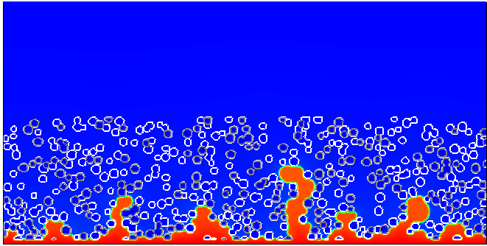
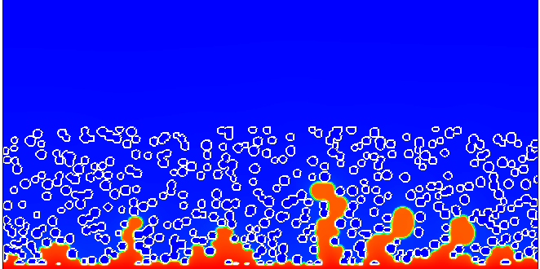
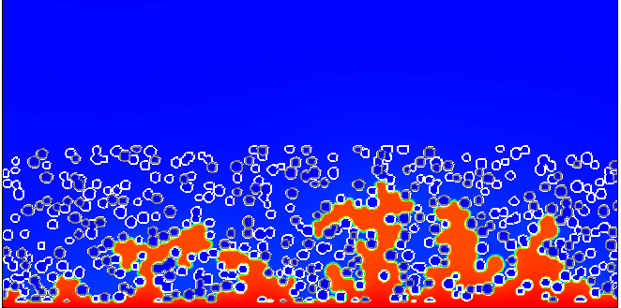
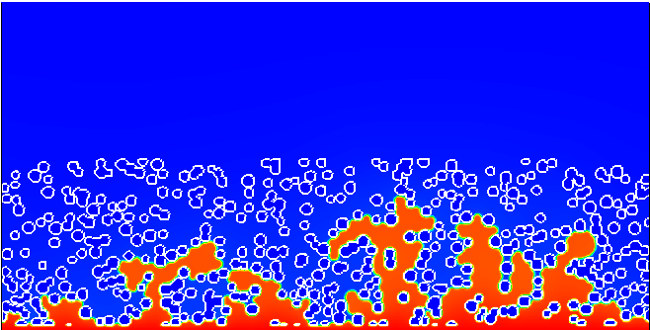
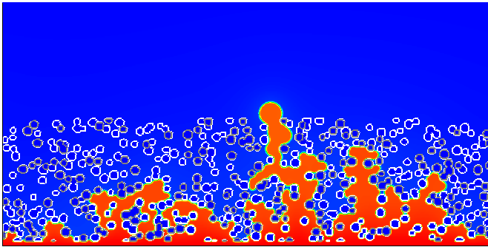
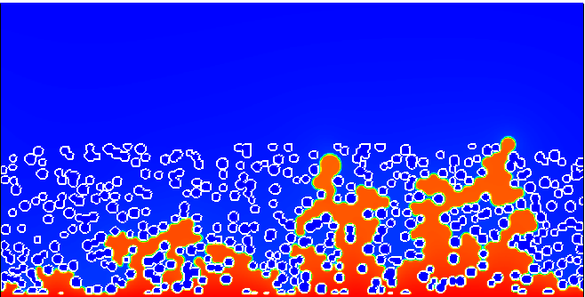
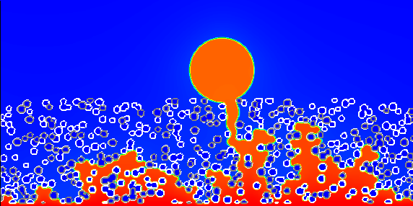
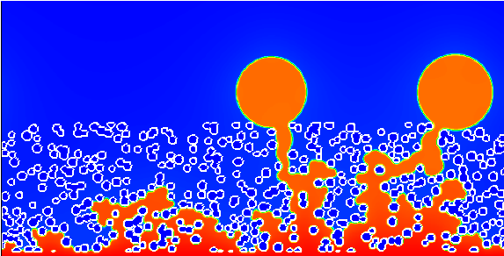
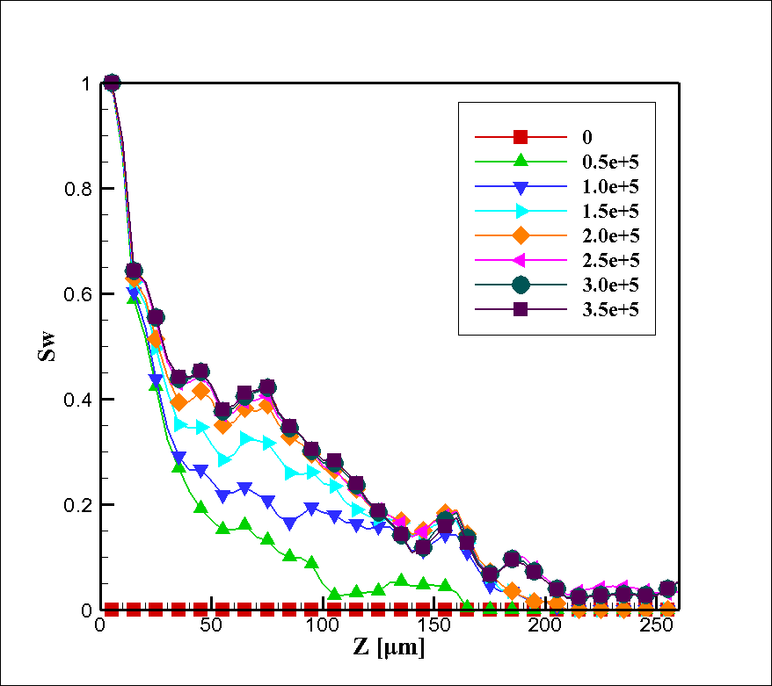
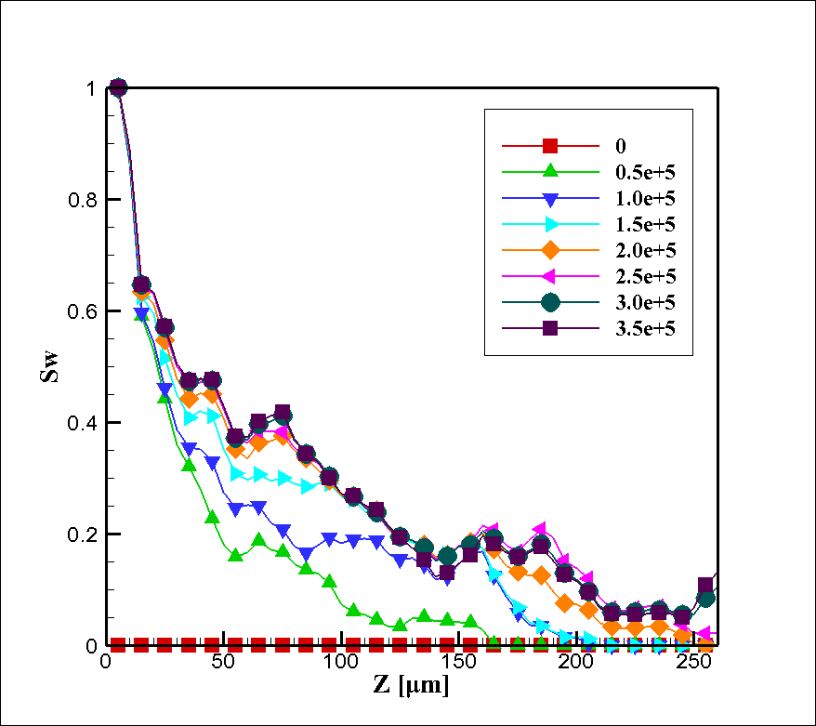
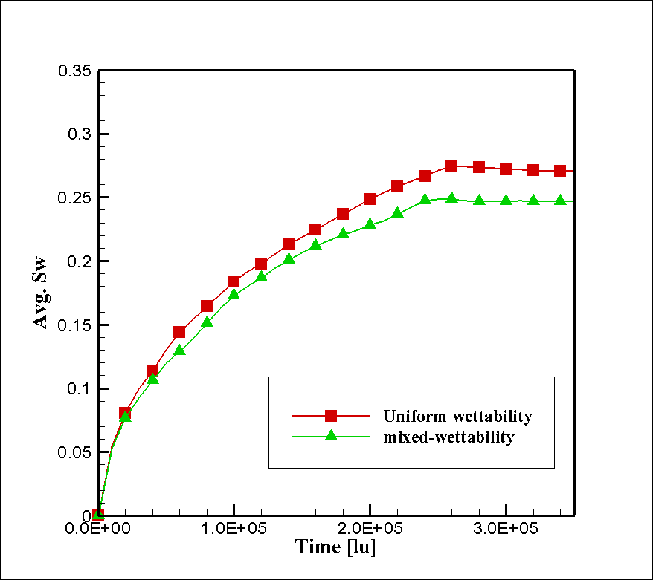
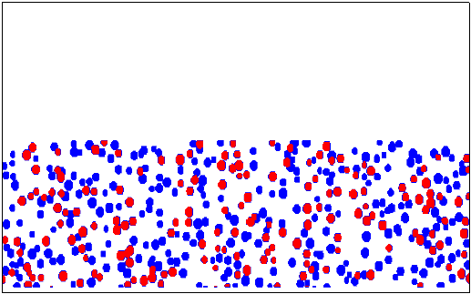
Two-dimensional Lattice Boltzmann Simulation of Liquid Water Transport
in Gas Diffusion Layers of PEMFCs
Seung Hun Lee¹, Jung Ho Kang², Jin Hyun Nam^{3,*}, Hyung Min Kim⁴
¹School of Mechanical & Aerospace Engineering, Seoul National University
²Air Conditioning and Energy Solution R&D Group, LG Electronics
³School of Mechanical Engineering, Daegu University
⁴Department of Mechanical System Engineering, Kyonggi University
Research Background & Objectives
Results and Discussion
• Research Background
• Snapshots from LB Simulations
Liquid water transport in gas diffusion layers (GDLs) of PEMFCs
GDL wettability is a critical factor for cell performance by influencing the liquid water content inside the PEMFC
Hydrophobic PTFE coating is commonly used to facilitate the liquid water drainage from GDLs
• Objectives
^{(*)} Liquid water and air is treated as two different components, and
water condensation/evaporation is not considered
Multi-phase^{(*)} lattice Boltzmann method (LBM) is adopted to study the dynamic transport behaviors of liquid water in mixed-wettability GDLs
The effects of hydrophobic/hydrophilic particle proportion on the liquid water transport and saturation level are investigated
Theory & Calculation
• Lattice Boltzmann Method (LBM)
ˆ
ˆ
ˆ
e
e
e
Derived from gas kinetic theory, the Motion of molecules are expressed by distribution function
By adopting BGK (Bhatnagar-Gross-Krook) model for collision terms, LB equation is expressed in terms of discrete particle distribution
6
2
5
ˆ
ˆ
e
ˆ
e
3
e
1
0
Here, is relaxation time and is equilibrium distribution and is lattice velocity in each direction
ˆ
ˆ
ˆ
e
e
e
7
4
8
Fig. 1 Two-dimension nine-velocity
(D2Q9) model
By applying D2Q9 model (Fig. 1), the discretized LB equation is expressed as
Fig. 4 Liquid water distribution with mixed-wettability: 80° (gray) vs. 110° (white) is (a) 50% PTFE-coated, (b) 100% PTFE-coated
The equilibrium distribution is derived from Maxwell-Boltzmann distribution function as
Initialize
from initial condition
As the portion of hydrophobic carbon fibers (PTFE-coated) increases, more paths are required for liquid water transport in GDL
Only one breakthrough is observed in mixed-wettability case vs. uniformly hydrophobic case
Mixed-wettability seems to facilitate the formation of preferential paths for liquid water transport by reducing capillary entry pressure, which in turn reduces liquid water saturation
In mixed-wettability GDL, liquid water tends to concentrate around a single transport path that is easier to flow through
Where the density, velocity, and weighting factors are calculated as
Streaming step :
Apply boundary condition and compute
Iteration
loop
• Liquid Water Saturation in GDL
Collision step :
(a)
(b)
(c)
Shan & Chen, 1993, Phys. Rev. E
Fig. 2 The numerical flowchart of
lattice Boltzmann method
Shan-Chen Model for multi-phase interaction
Fluid-fluid interaction:
Fluid-solid adhesion:
Interaction potential:
Fig. 5 Liquid water saturation profile of (a) mixed-wettability (50% PTFE-coated), (b) uniformly hydrophobic (100% PTFE-coated), (c) average saturation
• Model GDL Structure
The saturation difference is more noticeable above 150 μm thickness of GDL
The saturation profile is higher in uniformly hydrophobic case than mixed-wettability case
The time for reaching the steady state is slightly faster in the mixed-wettability case
The average saturation level increases as the portion of PTFE-coated carbon fibers increases from 50% to 100%
There seem to be an optimal portion of PTFE-coated carbon fibers which minimize the saturation level in GDL
2D random structure
Total: 1000×500 lu (1000×500 μm)
GDL: 1000×250 lu (1000×250 μm)
Porosity of GDL ~ 0.72
Circular particles are randomly generated in the domain, by varying radius (6~9 μm) and position
Particle wettability is also randomly assigned according to given proportion
Fig. 3 Generated GDL structure with mixed-wettability (contact angle: red=80°, blue=110°)
Conclusion
• Inlet Condition for Liquid Water entering GDL
We conducted LBM simulation for two-phase transport of liquid water in mixed-wettability and uniformly hydrophobic GDLs of PEMFCs
The result indicates that the mixed-wettability GDLs can reduce the liquid water saturation level and thus enhance gas diffusion in GDL
LBM is believed to be a proper analysis method for simulating microscale, two-phase, capillary-driven liquid water transport in porous GDLs
Inlet condition is known to be an important factor that alters the liquid water distribution inside GDLs
There are generally two broad categories: Uniform flux BC (UFBC) and uniform pressure BC (UPBC)
We adopted the UPBC by placing 10-lu (10-μm) height void space just under the GDL domain
Inlet velocity is set to a sufficient low value to ensure that capillary-driven liquid water transport occurs in the model GDL structure
Contact information
* Corresponding author. jhnam@daegu.ac.kr (J.H. Nam).

