Slide 1
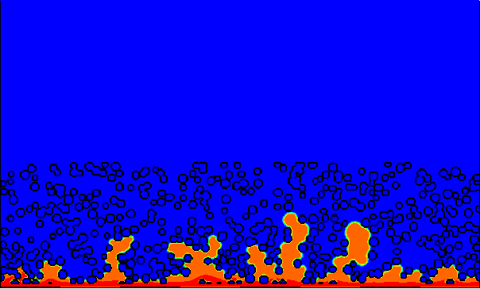
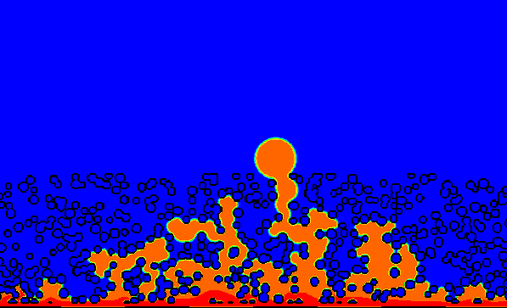
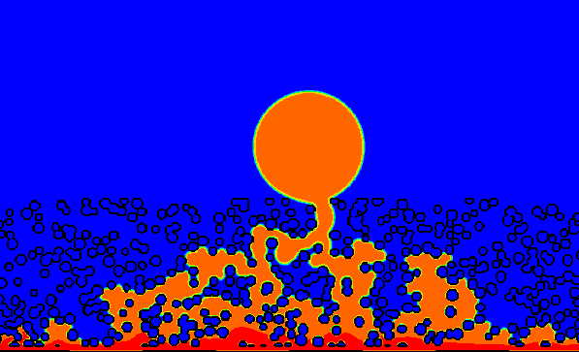
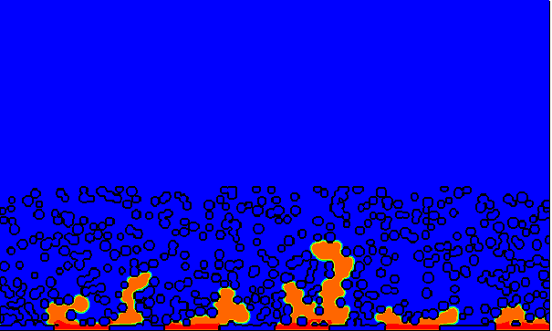
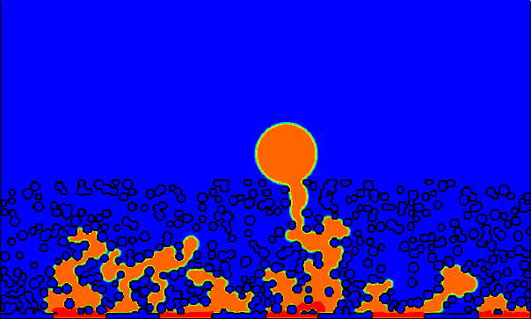
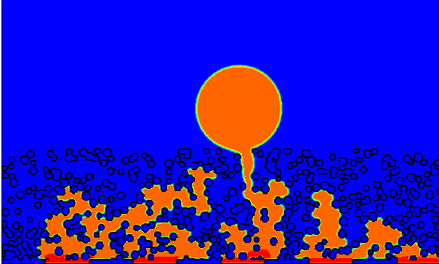
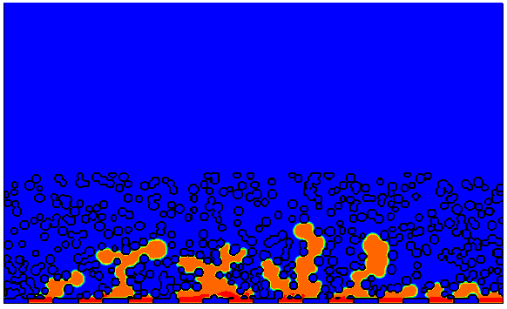
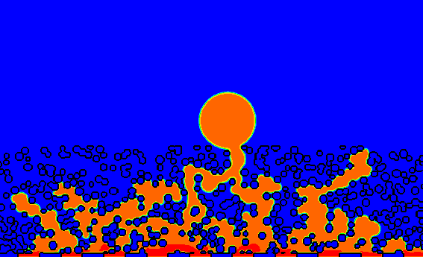
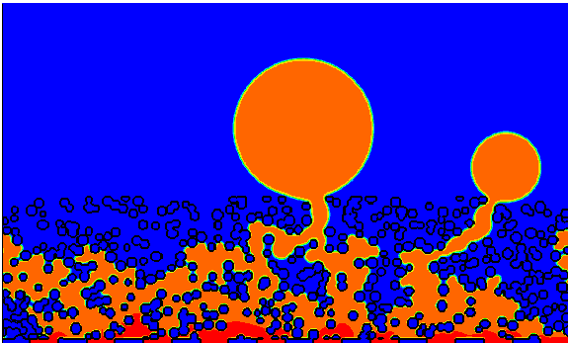
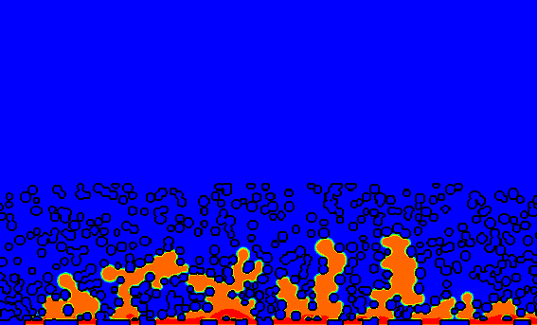
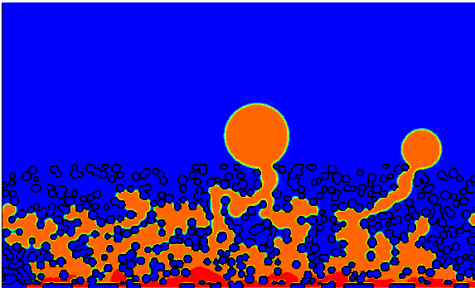
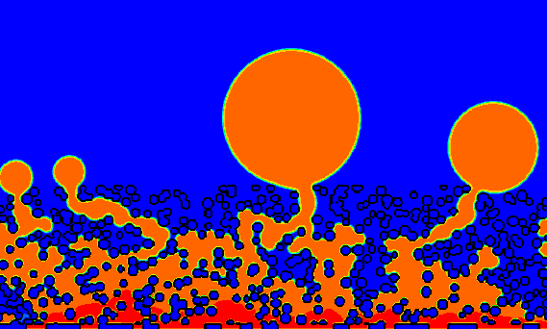
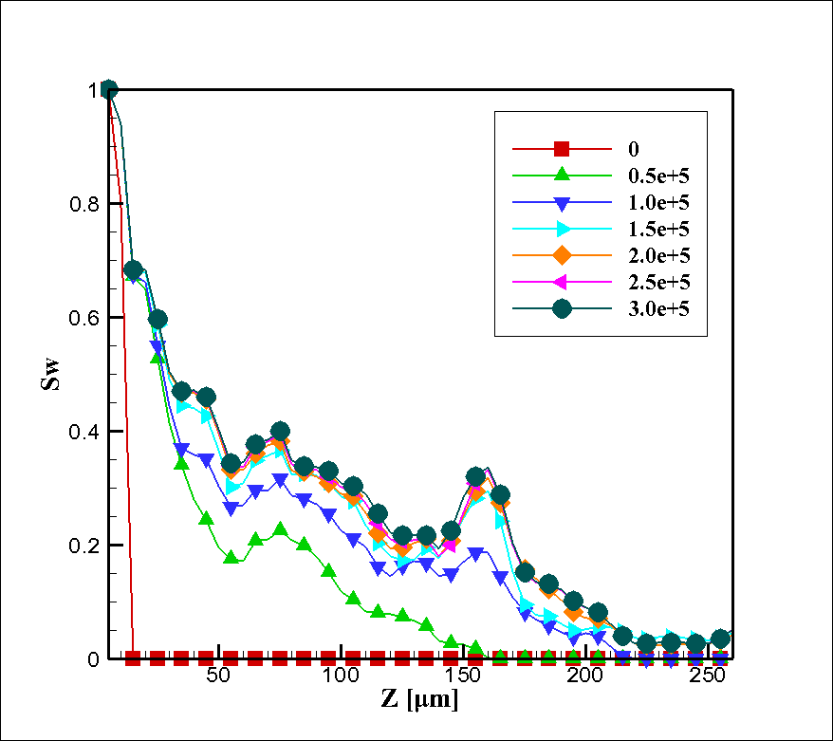
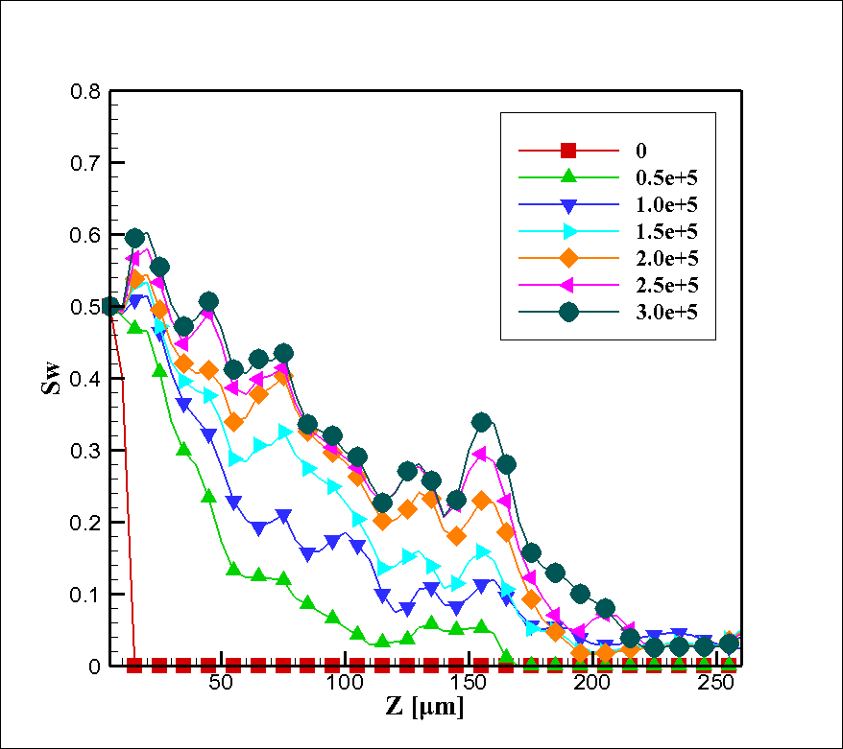
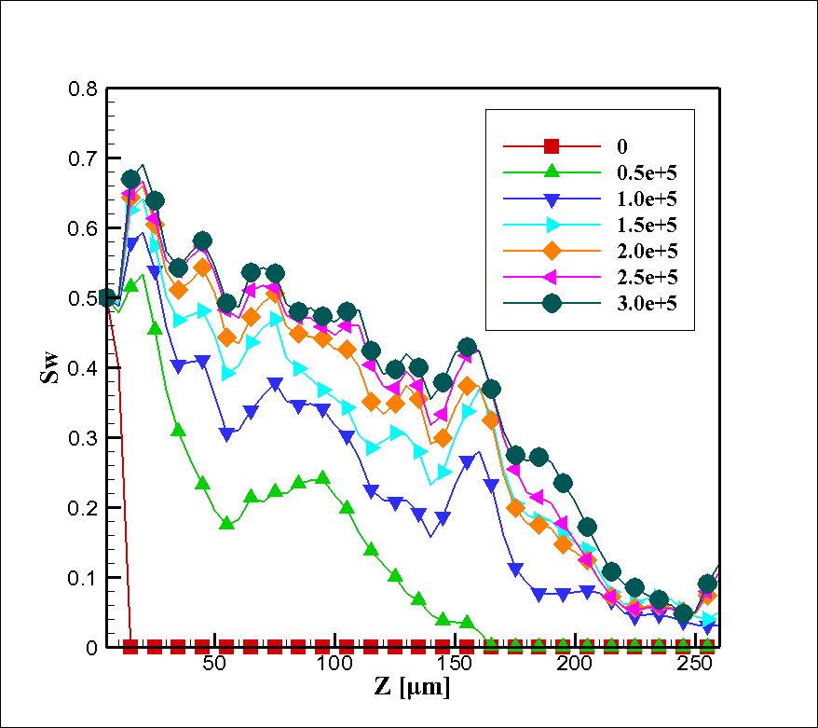
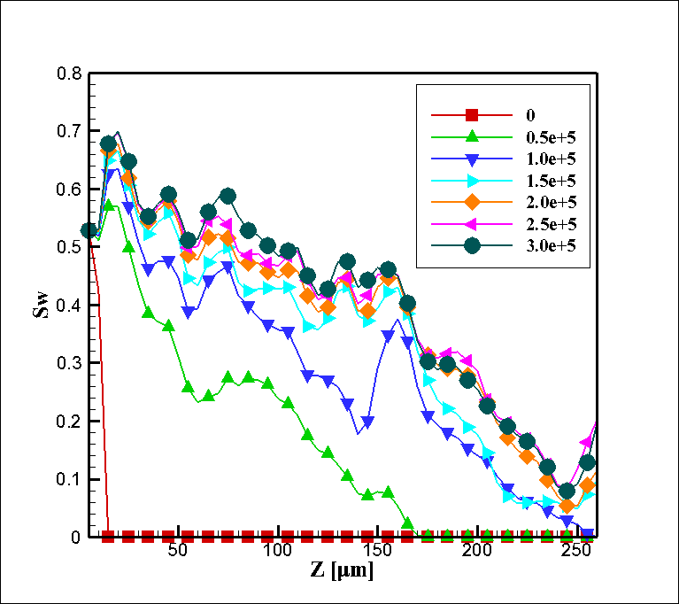
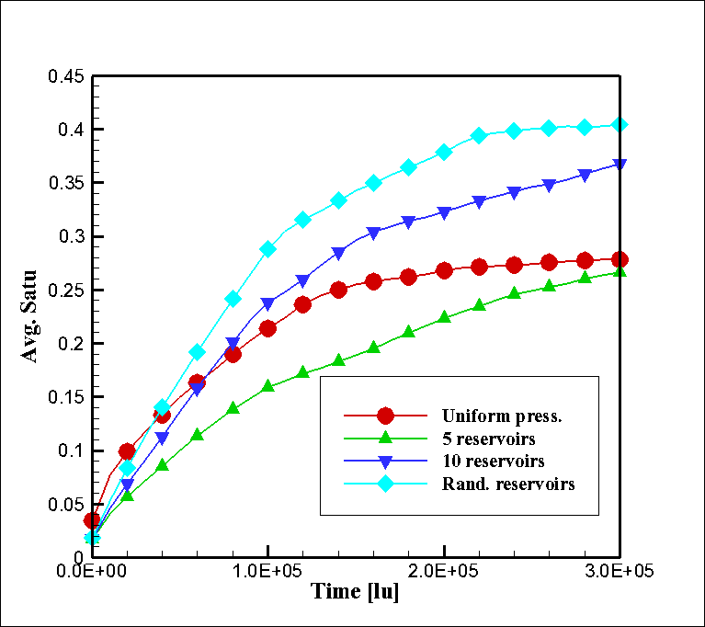
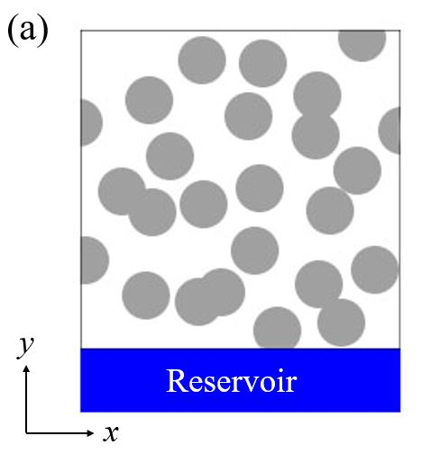
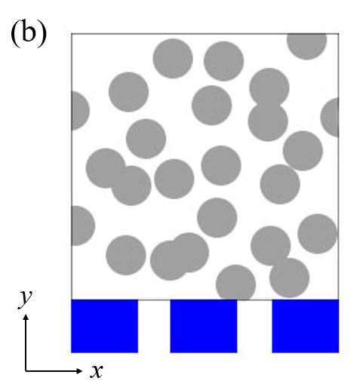
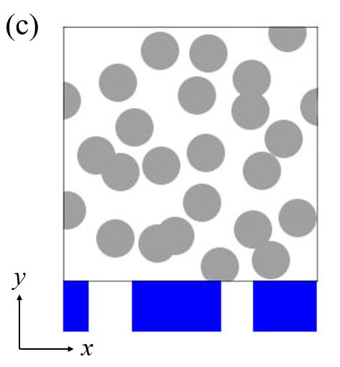
Lattice Boltzmann Simulation of Water Transport in Gas Diffusion Layers of PEMFCs with Different Inlet Conditions
Seung Hun Lee¹, Jin Hyun Nam^{2,*}, Hyung Min Kim³, Charn-Jung Kim¹
¹School of Mechanical & Aerospace Engineering, Seoul National University
²School of Mechanical Engineering, Deagu University
³Department of Mechanical System Engineering, Kyonggi University
Research Background & Objectives
Results and Discussion
• Research Background
• Snapshots from LB Simulations
Interface condition at the inlet boundary of the gas diffusion layers (GDLs) is an important factor for liquid water transport therein
  Liquid water saturation level inside GDL is significantly affected by how water is introduced into GDL from CL or MPL
  Two ideal inlet boundary conditions are generally considered (uniform pressure BC (UPBC) and uniform flux BC (UFBC)
(a) Uniform pressure
• Objectives
^{(*)} Liquid water and air is treated as two different components, and
water condensation/evaporation is not considered
(b) 5 reservoirs (regular size and location)
Multi-phase^{(*)} lattice Boltzmann method (LBM) is adopted to study the dynamic transport behaviors of liquid water in GDLs
The effects of different inlet boundary conditions on the liquid water transport and saturation level are investigated
Theory & Calculation
(c) 10 reservoirs (regular size and location)
• Lattice Boltzmann Method (LBM)
ˆ
ˆ
ˆ
e
e
e
Derived from gas kinetic theory, the Motion of molecules are expressed by distribution function
By adopting BGK (Bhatnagar-Gross-Krook) model for collision terms, LB equation is expressed in terms of discrete particle distribution
6
2
5
(d) Random reservoirs (12 reservoirs , random size and location )
ˆ
ˆ
e
ˆ
e
3
e
1
0
Here, is relaxation time and is equilibrium distribution and is lattice velocity in each direction
ˆ
ˆ
ˆ
Fig. 4 Liquid water distribution with different inlet conditions
e
e
e
7
4
8
As the number of liquid water reservoir increases, more paths are formed for liquid water transport in GDL
  At the earlier times, liquid water transport behavior is observed to be similar in all cases; however, the difference becomes more conspicuous as the flow time progresses
  Similar characteristics of liquid water are shown in case (a) and (b) for small numbers of larger reservoirs vs. case (c) and (d) larger numbers of smaller reservoirs
  In sufficiently fewer reservoirs, liquid water tends to concentrate around a single transport path that is easier to flow through, which is comparable to the UPBC result
Fig. 1 Two-dimension nine-velocity
(D2Q9) model
By applying D2Q9 model (Fig. 1), the discretized LB equation is expressed as
The equilibrium distribution is derived from Maxwell-Boltzmann distribution function as
Initialize
from initial condition
Streaming step :
• Liquid Water Saturation in GDL
Where the density, velocity, and weighting factors are calculated as
Apply boundary condition and compute
(a)
(b)
(c)
Iteration
loop
Collision step :
Shan & Chen, 1993, Phys. Rev. E
Fig. 2 The numerical flowchart of
lattice Boltzmann method
(d)
(e)
Fig. 5 Liquid water saturation profile of (a) UPBC, (b) 5 reservoirs, (c) 10 reservoirs, (d) randomly distributed reservoirs, (e) average saturation
Shan-Chen Model for multi-phase interaction
  Fluid-fluid interaction:
  Fluid-solid adhesion:
  Interaction potential:
• Inlet Condition for Liquid Water entering GDL
In UPBC case, the saturation profile shows lowest saturation level and the time for reaching the steady state is fastest
The saturation difference is clearly observed between case (b) and (c)
  The average saturation level increases as the number of separate liquid water reservoirs increases
  In UPBC case, the number of inlet reservoirs is a more important factor that governs the liquid water saturation level in GDL than the size of the reservoirs
The total domain size is 1000×600 lu (1000×600 μm) with GDL region of 1000×250 lu (1000×250 μm)
  Uniformly hydrophobic circular inclusions are formed in the GDL region to model porous structure (contact angle = 110°, porosity = 0.72)
  Uniform pressure BC (UPBC) is implemented by placing a single reservoir (height 10 lu) under the GDL domain
Uniform flux BC (UFBC) is implemented by placing many small reservoirs (50% of inlet surface) segmented by solid walls
  For regular cases, the reservoir size is uniform (regular case), and for random cases, the size is randomly chosen 20-100 lu
  Inlet velocity is set to a sufficient low value to ensure that capillary-driven liquid water transport occurs in the model GDL structure
Conclusion
We carried out two-phase LB simulations for the liquid water transport in GDLs of PEMFCs with different inlet boundary conditions
  The result indicates that the number of reservoirs at the inlet boundary of GDL significantly influences the liquid water saturation level
  Minimizing the number of inlet reservoirs can reduce the liquid water saturation level and thus enhance gas diffusion in GDL
Fig. 3 Schematic GDL structure with different inlet conditions:
(a) UPBC (b) UFBC (c) randomly distributed BC
Contact information
* Corresponding author. jhnam@daegu.ac.kr (J.H. Nam).

