Slide 1
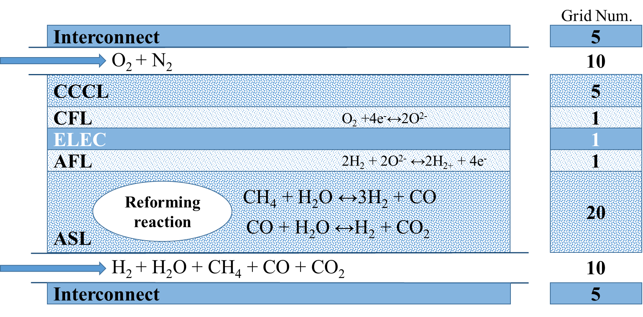
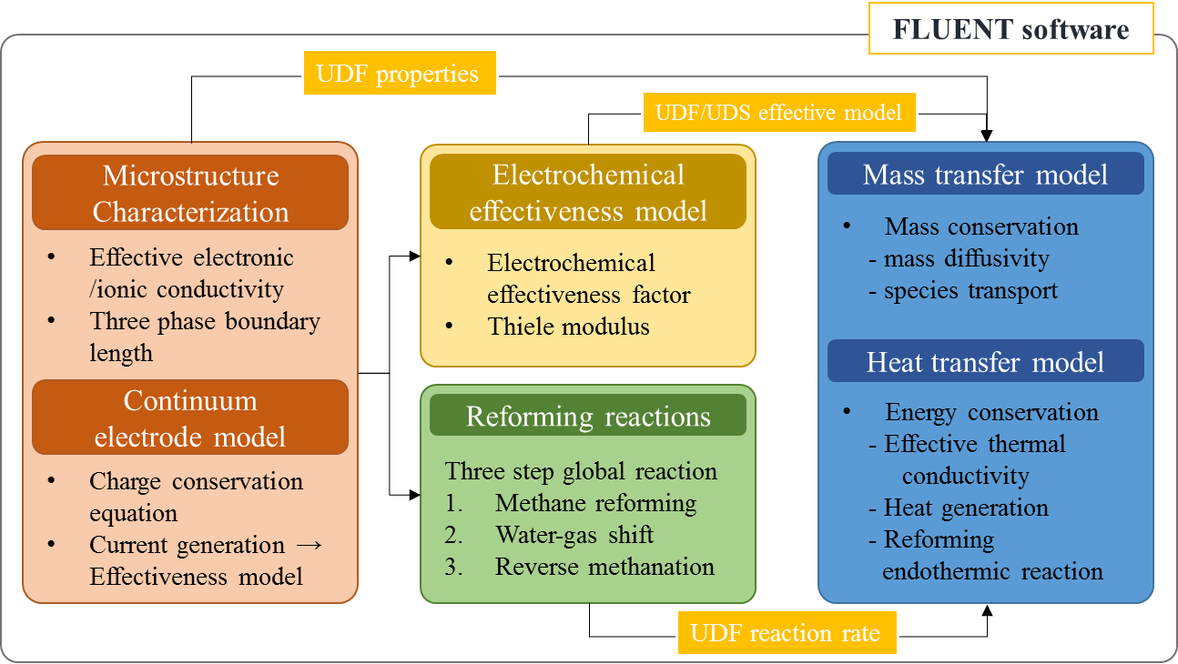
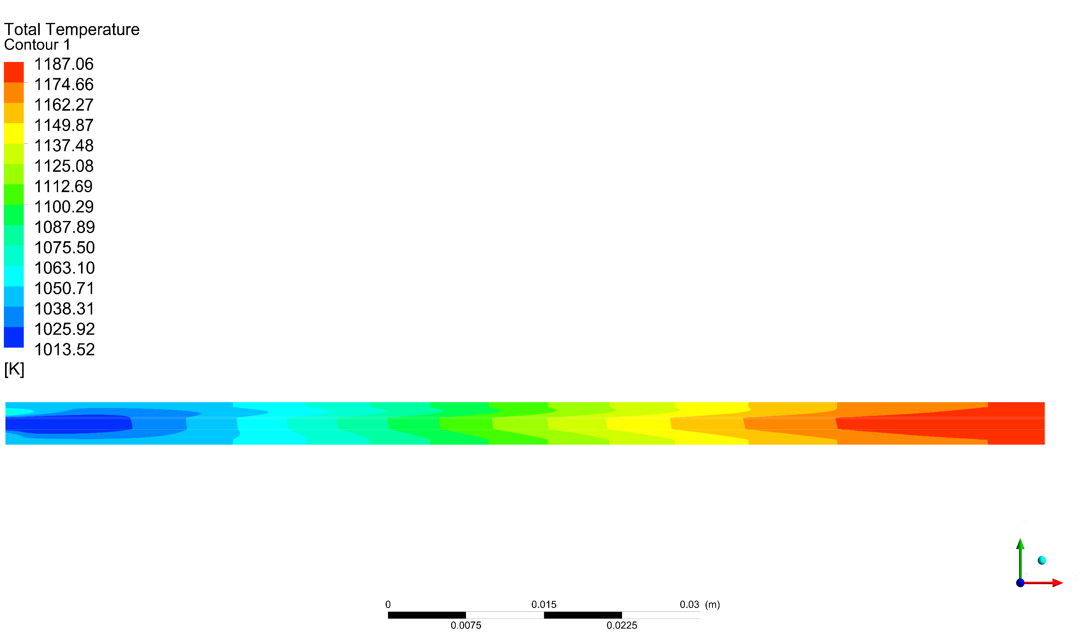
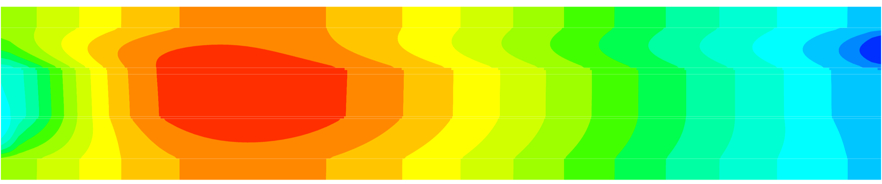

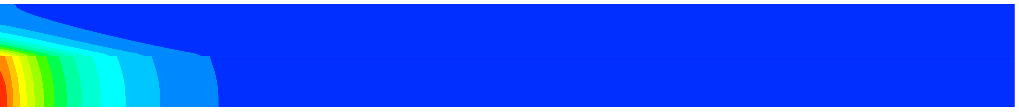

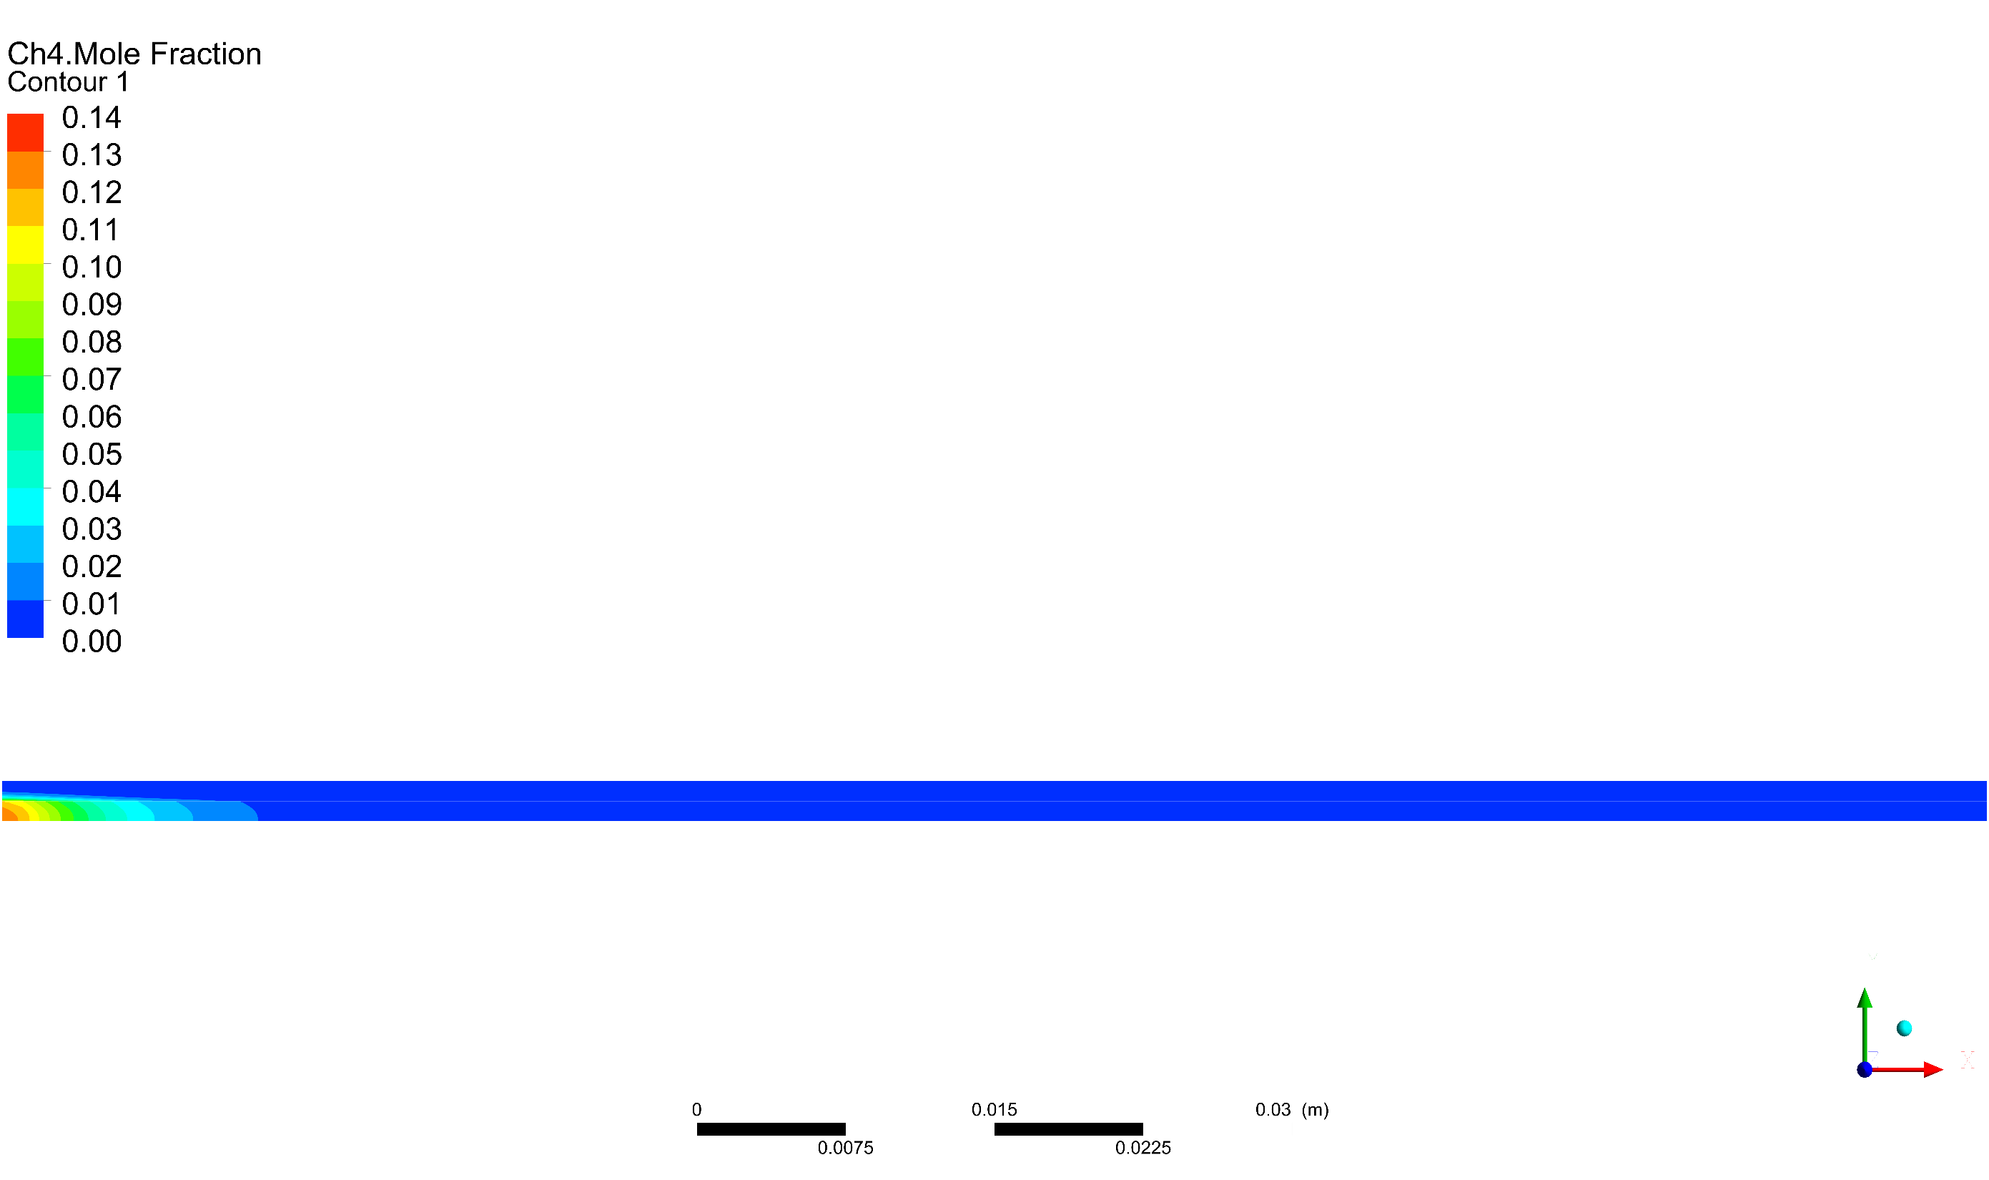
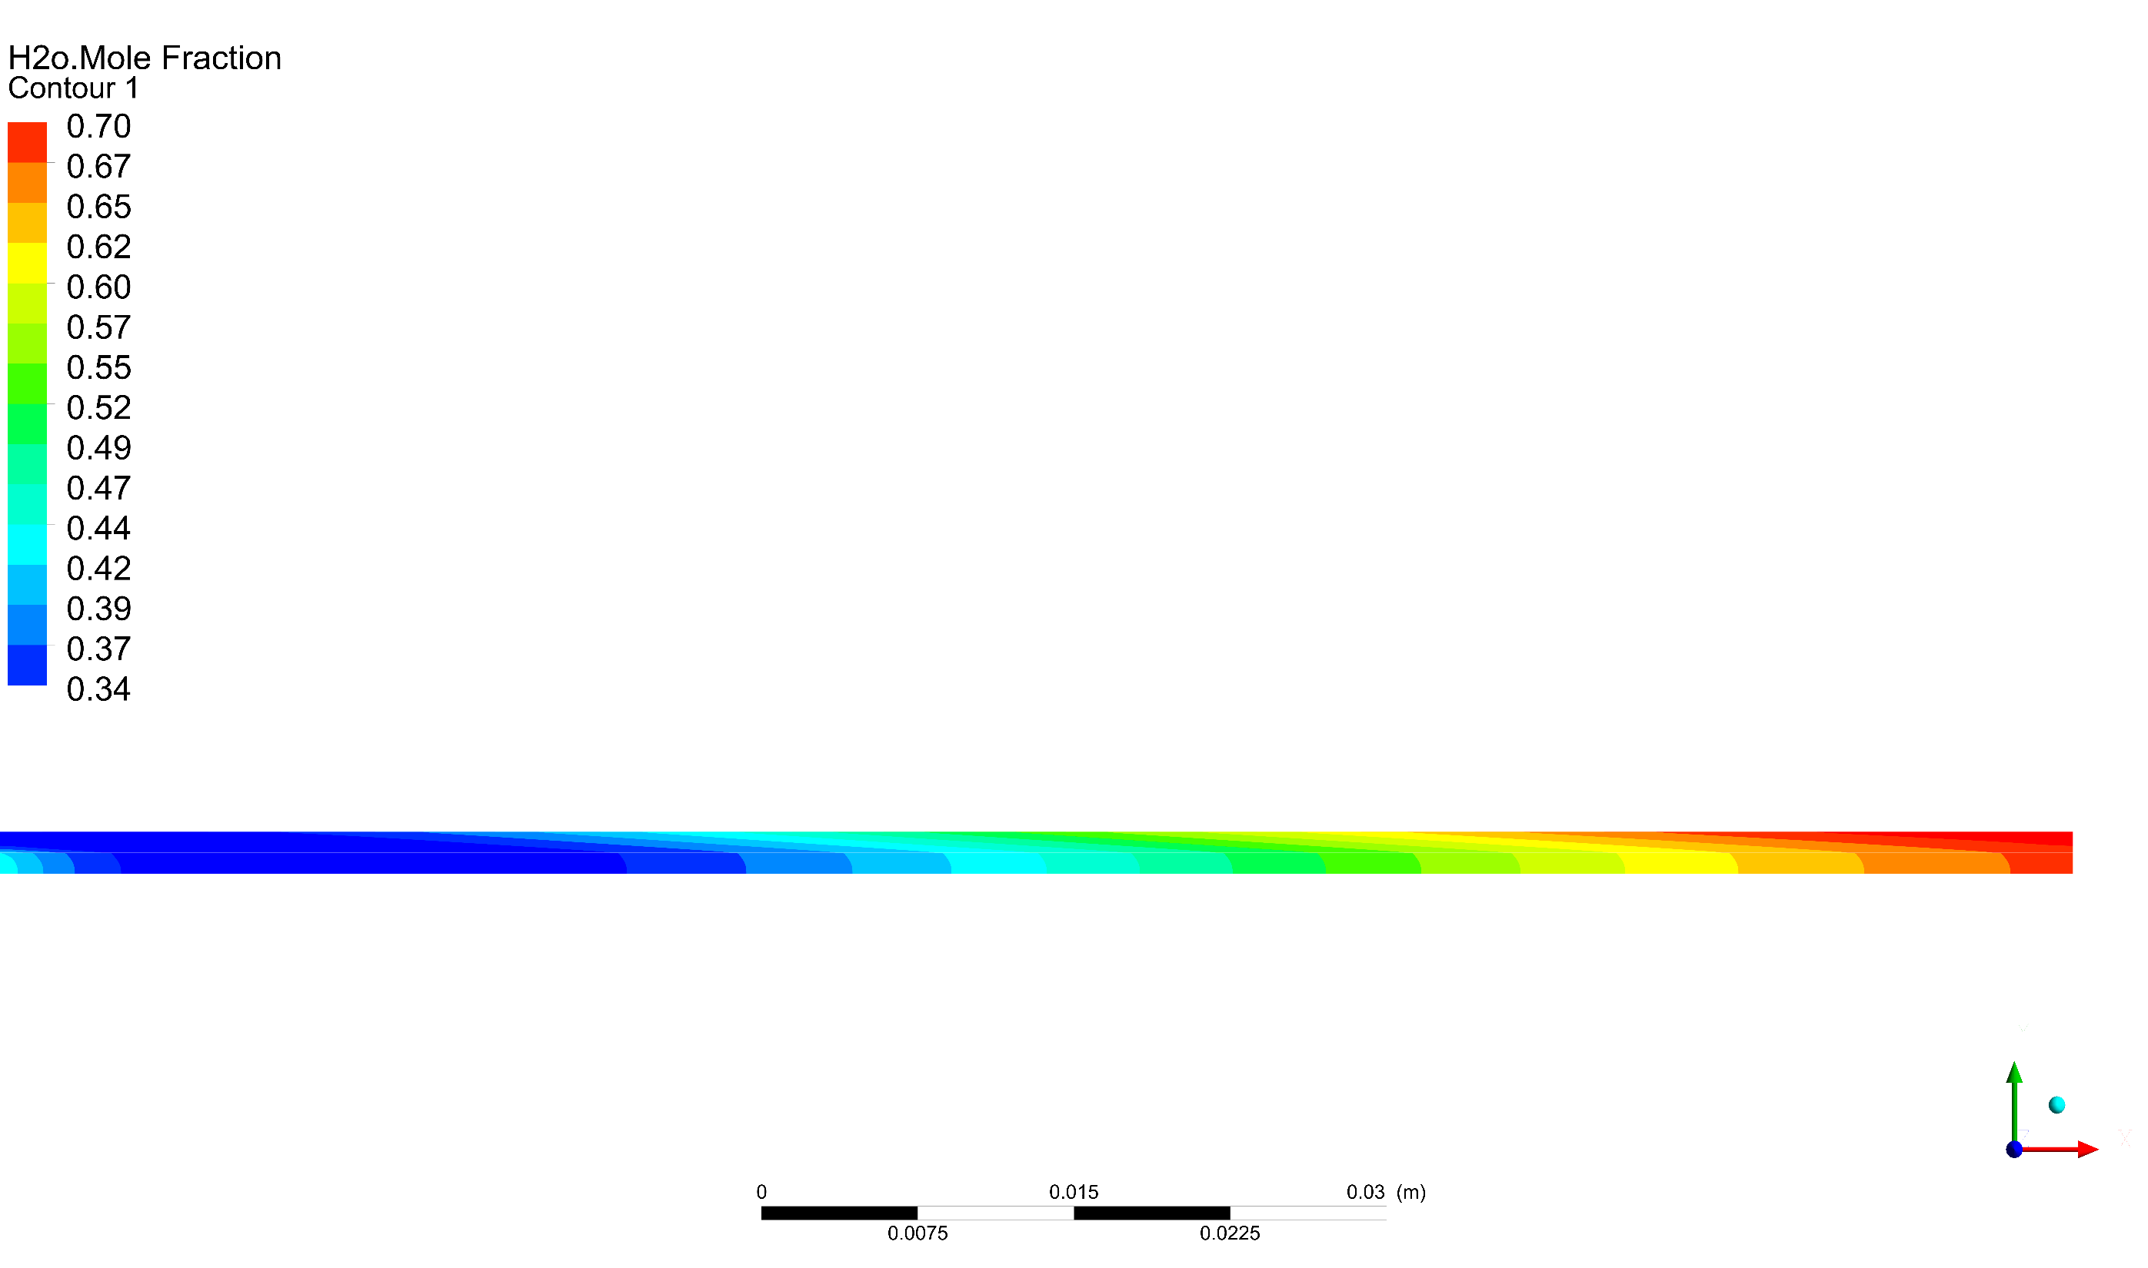

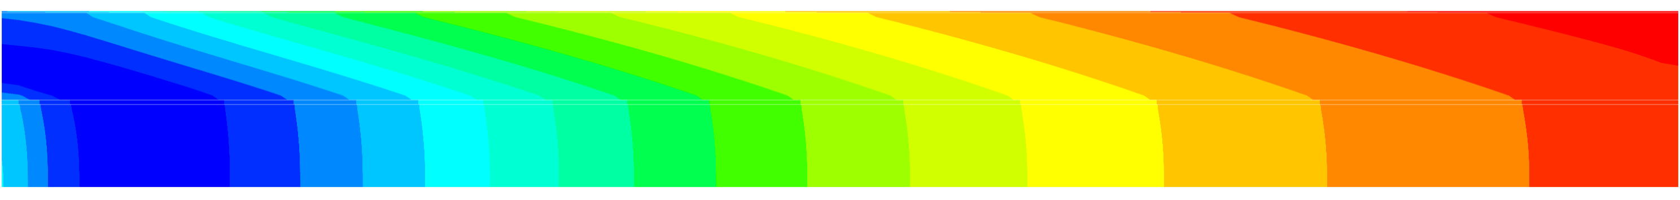
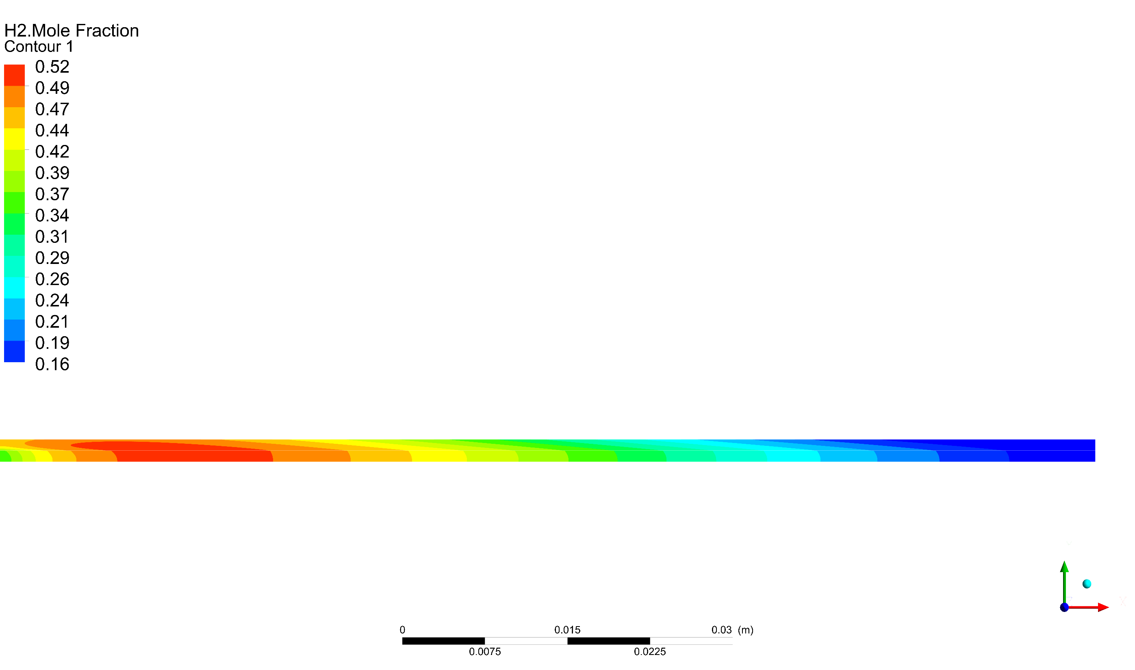

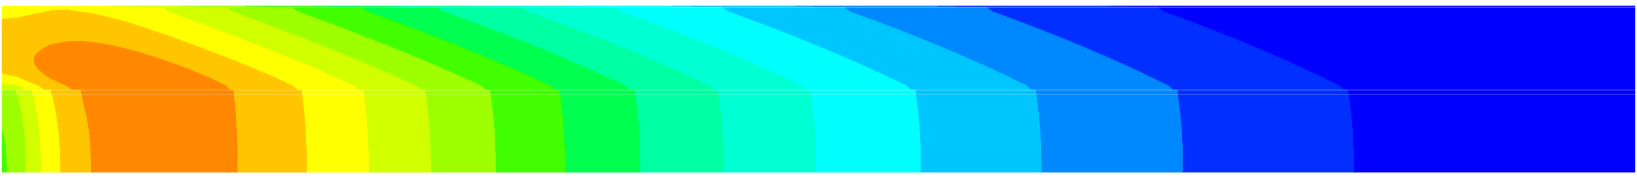
A computational Fluid Dynamics Model development for SOFCs with Direct Internal Reforming base on Electrochemical Effectiveness Concept
A. Jeong¹ , J. H. Nam^{2*}, C.J. Kim¹
¹School of Mechanical & Aerospace Engineering, Seoul National University, KOREA
²School of Mechanical Engineering, Daegu University, KOREA
Research Objectives
Results and Discussion
• Objectives
• Current-Voltage Performance
Sohn et al., 2016, Int. J. Hydrogen Energy
Development of an efficient two-dimensional CFD model for simulating planar, anode-supported SOFCs operated with methane gas (internal reforming is considered)
  FLUENT is used as a numerical platform for conservation and transport calculation
  Charge transport and electrochemical reaction in the active reaction layers are accurately considered by the electrochemical effectiveness model
  Validation of model by comparison with previous micro/macroscale model results
Good agreement is found between the present CFD model and the previous micro/macroscale model
Counter-flow case shows better performance than co-flow case primarily because of higher temperature (higher reaction rate)
Numerical Model
• Anode-supported SOFCs
Cell length = 10 cm
0.745 V
0.679 A/cm₂
A five-layer PEN structure with straight gas channels and interconnect layers
0.780 V
0.666 A/cm₂
CINT (cathode interconnect layer) 0.5 mm
CGC (cathode gas channel) 1 mm
CCCL (cathode current collector) 50 μm
CFL (cathode functional layer) 20 μm
ELEC (electrolyte) 10 μm
AFL (anode functional layer) 20 μm
ASL (anode substrate layer) 1 mm
AGC (anode gas channel) 1 mm
AINT (anode interconnect layer) 0.5 mm
Total 9000 cells is used in FLUENT
Standard condition
~65% Fuel Utilization
(0.65 A/cm²)
• Temperature Distribution (K)
In co-flow case, temperature gradually increases along the flow direction; the lowest temperature appears near the inlet due to active reforming reaction
In counter-flow case, the maximum temperature appears in between the inlet and outlet; temperature is lower near the fuel inlet due to reforming reaction and is lowest near the air inlet due to cooling
• Model Configuration
Only one cell is placed in AFL or CFL (in thickness)
Various sub-models are incorporated into FLUENT platform utilizing the user-defined function, scalar, and memory (UDF, UDS, UDM) capabilities
Co-flow configuration @ V_{cell} = 0.745 V & i_{cell} = ~0.65 A/cm²
Air Channel
Anode
Counter-flow configuration @ V_{cell} = 0.780 V & i_{cell} = ~0.65 A/cm²
Fuel Channel
Air Channel
Anode
Computational Model
Fuel Channel
Effectiveness Model
Shin and Nam, 2015, Electrochim. Acta
• Species Mole Fraction in Anode
Using effectiveness model, significant calculation cost is saved w/o accuracy loss
Mole fraction of CH₄ shows that reforming reaction is completed near fuel inlet; counter-flow case has shorter reaction zone due to higher temperature
Mole fraction of H₂O decreases due to reforming reaction and increase due to electrochemical reaction (mole fraction of H₂ shows opposite behaviors)
Γ_{eff} = Effectiveness factor
Co-flow
Mole fraction of CH₄
Anode
Effectiveness factor is composed of the base effectiveness and the relative effectiveness
Fuel Channel
Counter-
Anode
Mole fraction of H₂O
Fuel Channel
Co-flow
Anode
Correlation eq.
Fuel Channel
Counter-
Anode
Reforming reaction
Mole fraction of H₂
Fuel Channel
Global three-step reforming is assumed to occur inside ASL
Co-flow
Anode
React. I (SR, steam reforming):
React. II (WGS, water-gas shift):
React. III (RM, reverse methanation):
Fuel Channel
Counter-
Anode
Intrinsic reaction kinetics proposed by Xu and Froment (1989) is used
Fuel Channel
Xu and Froment, 1989, AIChE J.
Conclusion
A two-dimensional CFD model for planar, anode-supported, methane-fueled SOFCs is developed and validated
Electrochemical effectiveness model is utilized to accurately predict the current generation rate in the active reaction layers with less computational costs
The proposed numerical approach enables the efficient consideration of electrode microstructural effects in CFD calculation platform
Simulated Operating Condition
 | Anode side | Cathode side
Inlet species | H₂, H₂O, CH₄, CO, CO₂ | O₂, N₂
Inlet temperature, T∞ (°C) | 800 | 800
Steam-to-carbon ratio, SC | 2.5 | 2.5
Pressure, p_{t,∞} (bar) | 1 | 1
Limit current density (A/cm²) | 1.0 | 4.0
Contact information
* Corresponding author. jinhnam@gmail.com (J.H. Nam).

